Slide 1


OVERVIEW
The “Buildable” Toolkit,
why it’s needed, how it is leveraged,
and what are its outputs.

Slide 2
TABLE OF CONTENTS
Why is this Toolkit important?
What is the overall process?
Who should be involved in the TWG… and why?
What template “tools” are leveraged… and when?
What are the Toolkit’s outputs… and how should we use them?

Slide 3

Why is this Toolkit important?

Slide 4



Over the last decade, digital health investments have often focused on measuring aggregate indicators (outputs).
Σ

Slide 5


But to improve population health outcomes,
we want to leverage digital health to improve our
person-centric care delivery activities (inputs).
Σ

Slide 6
Leveraging Computable Care Guidelines (CCGs), care-focused
digital health solutions can support broad adoption of
evidence-based best practices across the whole care delivery network.
Σ
CCGs

Slide 7



When we use digital solutions to support improved care, we will generate person-centric health data in a computable format. From these data, we can automatically develop aggregate indicators.
Σ

Slide 8
This reduces health workers’ burden of manual indicator data entry. Reducing this burden creates capacity in the health workforce.
Σ

Slide 9


The role of the Toolkit is to support the re-engineering of care delivery operations to make best use of digital health infrastructure. Important implementation and investment plans will result from using the Toolkit.

Slide 10

KEY TAKEAWAY POINTS
We can adopt digital health as a means of improving person-centric care workflows which will, in turn, improve population health outcomes.
Person-centric data may be leveraged to automatically generate reportable indicators and metrics. This can reduce health workers’ burden of indicator data entry.
The role of the Toolkit is to help create the implementation and investment plans needed to support re-engineering of the care delivery network to make the best use of digital health.

Slide 11

What is the process the Toolkit follows?

Slide 12


The Toolkit is leveraged to facilitate the efforts of a technical working group (TWG). Over a short-duration project, the TWG will generate actionable construction artefacts including an investment rationale.
Deliver buildable digital health blueprint artefacts including the investment rationale needed to launch a national-scale HIE infrastructure implementation project.
Form a TWG.
Launch the Toolkit-facilitated process.

Slide 13



The TWG should include representatives from the MOH, from development partners / donors, from active NGOs, from care provider organizations, and from relevant partner ministries of the government.

Slide 14

The Toolkit-supported process will work to align digital health tactics to the digital health strategy and to the MOH’s overall health strategy.
What is the country’s burden of disease?
What is the current health system strategy?
(check for alignment to the burden of disease)
What is the current digital health strategy?
(check for alignment to the burden of disease and the health strategy)
How can digital health make an impact, and what conformance-testable infrastructure elements are needed?
Where are we now (current state) and what should be done to progress from the current state to the future state?
How will implementation activities drive costs and deliver benefits,
and what is the investment rationale for the proposed plan?

Slide 15

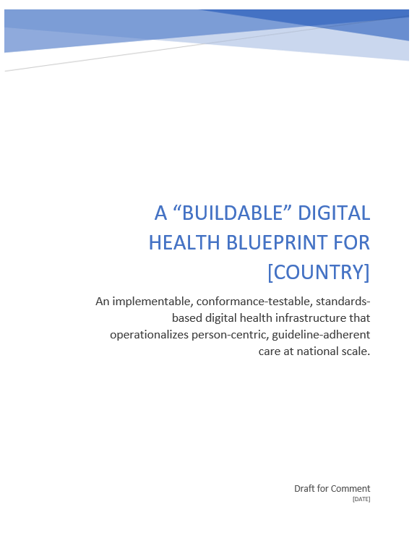






Multiple facilitated workshops with the TWG will be leveraged to generate relevant content documented in the blueprint artefacts.
Upstream
Activities
Downstream
Activities
Background Information
Research & Preparation
“Homework”
(pre-read materials)
Questions
For Discussion
PPT Deck
Real-time
Questionnaire Results
Real-time
Questionnaires
Consensus
Content
Iterative Workshop
Activities
Discussion
Blueprint Document
(incl. investment rationale)

Slide 16



Multiple facilitated workshops with the TWG will be leveraged to generate relevant content documented in the blueprint artefacts.
The Toolkit includes workshop facilitation aids (sample PPT, Google) plus a skeleton blueprint document, with helpful annotations.
PPT Deck
Real-time
Questionnaire Results
Real-time
Questionnaires
Blueprint Document
(incl. investment rationale)

Slide 17











To mitigate risk, the Toolkit leverages accepted international norms, standards, and conformance-testable architectural patterns. Data-informed decisions are based on credible global sources.

Slide 18
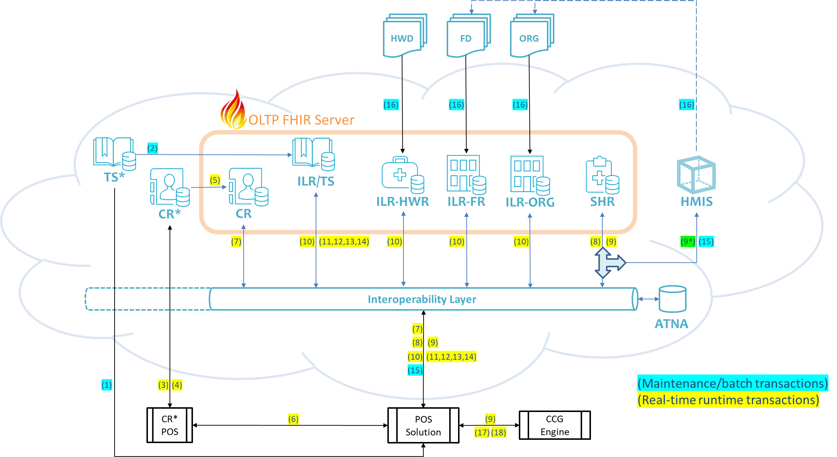

The Toolkit leverages a generic infrastructure design based on a small set of system “actors” executing standards-based, conformance-testable transactions with each other.

Slide 19
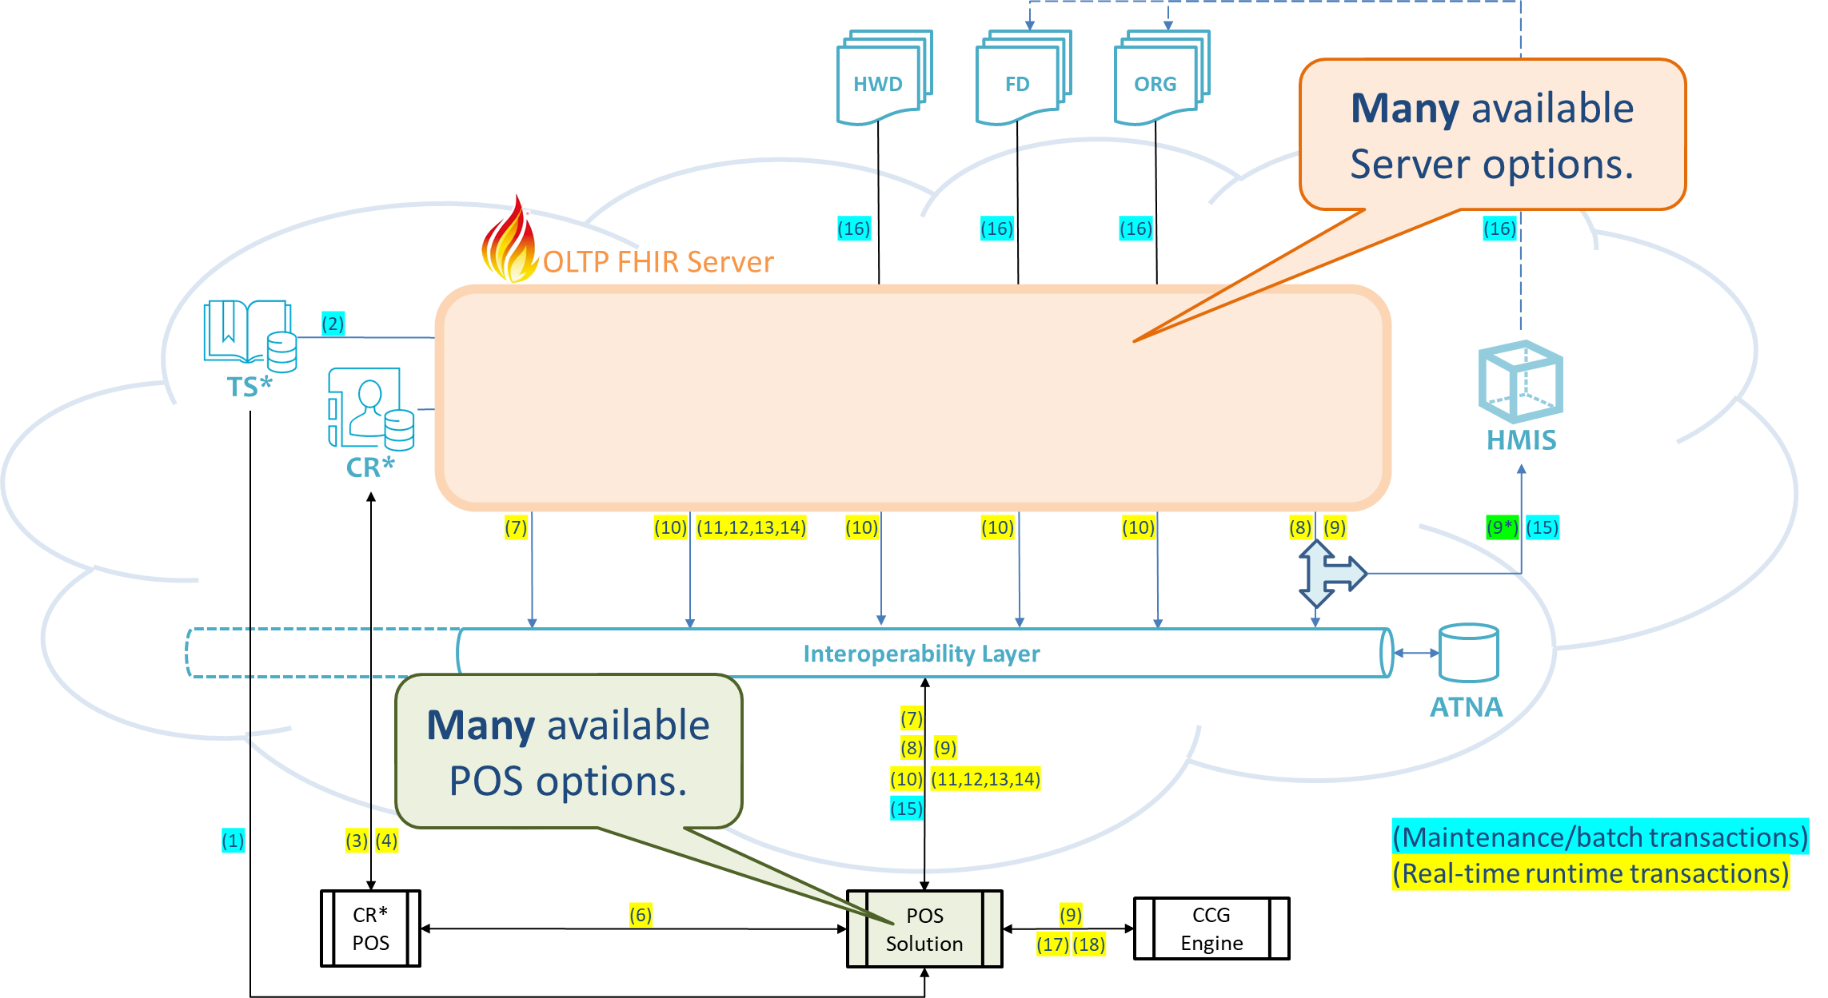

Because the specifications are based on widely-adopted standards, there is a wide array of commercial and open-source options that can be leveraged as ready-to-use building blocks.

Slide 20
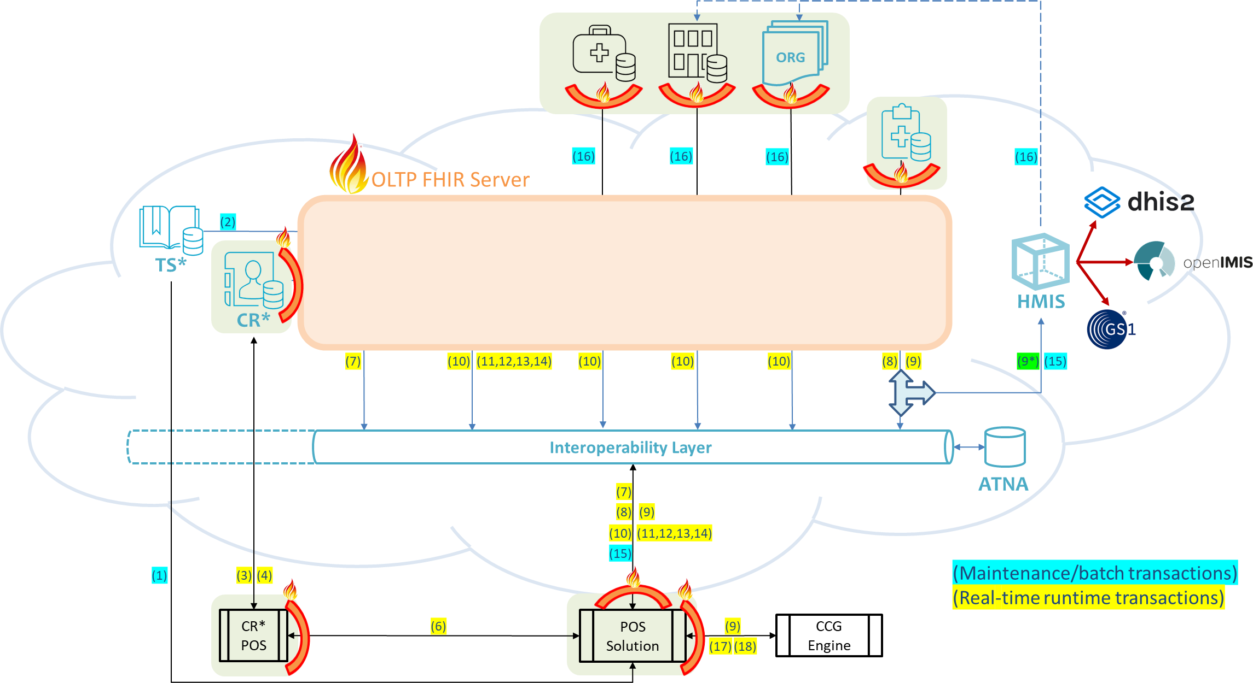
Where existing solutions have already been widely deployed, we can leverage a standards-based façade to connect these into the infrastructure and give the project a “running start”.

Slide 21
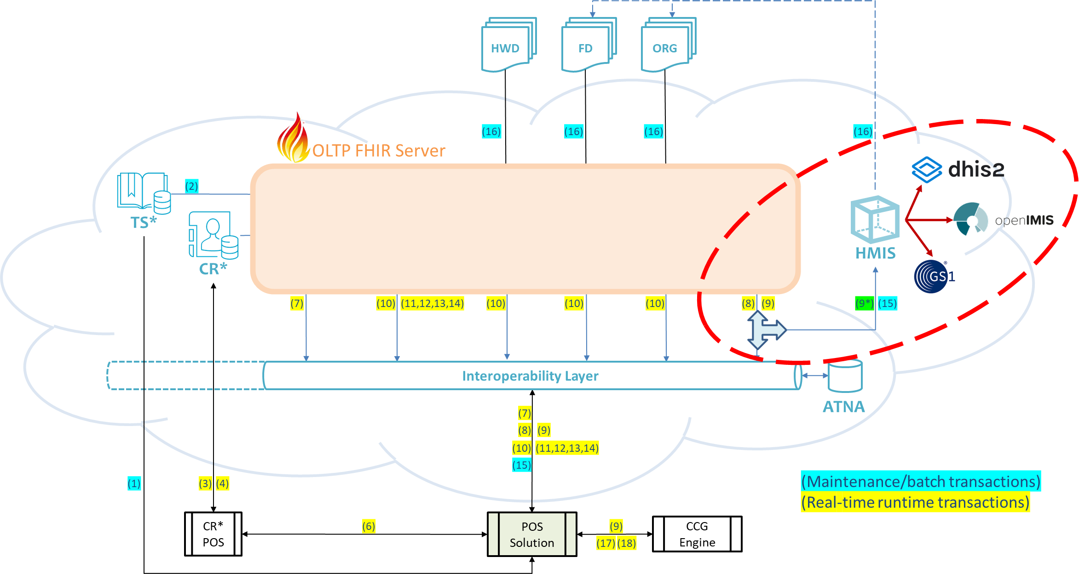
Leveraging an innovative “T-junction” design – HIE transactions can directly drive companion processes related to supply chain, financing, and health system management.

Slide 22




The investment rationale leverages an activity-based budgeting approach. Cost-utility analyses (CUA) are used to develop a DALYs-per-Dollar ROI forecast over a 10-year implementation planning horizon.
$
Money IN
Health OUT
ROI
time

Slide 23








Importantly, the investment rationale is predicated on whole-population impacts. This means the Toolkit has a whole-health-system scope including both private and public sector care delivery.
$
Money IN
Health OUT
All care providers will connect to the national digital health data sharing infrastructure. A patient’s data will follow them whenever and wherever they receive care.

Slide 24
This is a platform approach. OECD countries typically spend 2-5% of T.H.E. on digital health. The investment rationale illustrates systemic health gains from a system-wide digital health implementation.
+
$
$
Money IN
Health OUT
System-wide investments are big investments.
1% of a billion-dollar T.H.E. is $10M per year.

Slide 25
KEY TAKEAWAY POINTS
It is expected that the Toolkit will be leveraged by a multi-stakeholder TWG over a short-duration project.
The TWG will align tactics to existing digital health and health system strategies. An implementable, conformance-testable digital health specification will be developed that is based on the current context.
International best practices will be leveraged wherever possible to mitigate implementation risk.
The investment rationale will develop a DALYs-per-Dollar ROI metric over a 10-year planning horizon.

Slide 26

What will be the project outputs?

Slide 27

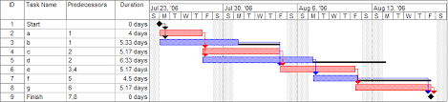

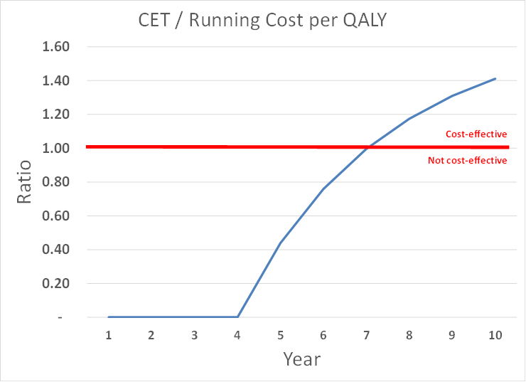


The key project outputs will be a contextual analysis, a conformance-testable, implementable, digital health design specification, and a 10-year investment rationale based on a notional implementation plan.

Slide 28
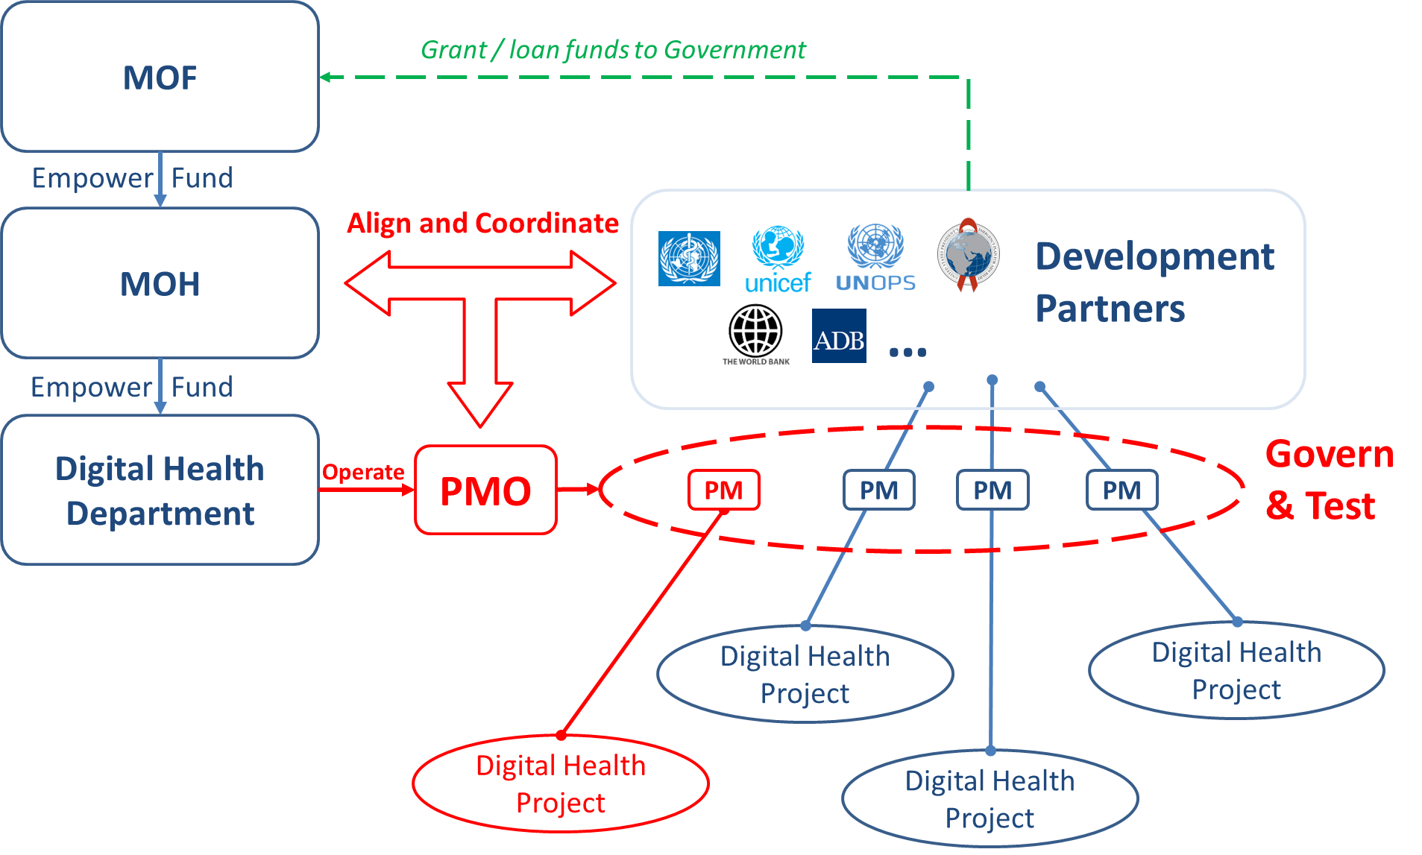

Based on the contextual analysis, recommendations related to governance and relevant legal frameworks (consent, privacy, etc.) will also be documented.

Slide 29








Digital health capacity-building is also a focus. A budget is developed in the Investment Rationale to educate and train our healthcare workforce.
Initial education in “data use”.
Annual “refresher” courses.
Establishment and operation of health informatics degree-granting programmes.

Slide 30
The blueprint artefact resulting from the Toolkit process will include chapters on each of these relevant sections, plus appendices. An example Table of Contents is shown below.
Introduction
National Burden of Disease
National Health & Digital Health Strategies
Components of a “Buildable” Health Information Exchange
Digital Health Landscape and Quick-win Opportunities
Governing the National HIE
HRH Capacity Building
Appendix: Example Use Case
Appendix: 10-year Roadmap & Associated Investment Rationale

Slide 31
KEY TAKEAWAY POINTS
The project outputs will be actionable artefacts.
The contextual analysis will align digital health tactics and designs to current strategies, deployments, and (where applicable) global best practices.
A buildable, conformance-testable, standards-based digital health specification will address contextual requirements.
The notional project plan will map a path from the current state to the desired future state.
The investment rationale will document costs and benefits over a 10-year horizon and support decision-making.
Where appropriate, governance and policy recommendations will be documented that can inform new legislation.

Slide 32

Questions and Answers?

